Slide 1
CYBER THREATS FACING THE NATION & DELAWARE
Delaware Statewide Exercise – August 25, 2022
Notes:
Hello, good morning! As mentioned, I am Arielle Baine, your regional cybersecurity advisor and cyber state coordinator for the state of Delaware. I’ll be kicking off the workshop with what I hope will be an interesting talk about the evolution of malware and future malware mitigations. Before I get into the discussion, I wanted to give a little bit of background information about the Cybersecurity Infrastructure and Security Agency (CISA) as well as about my role in the agency.

Slide 2
Notes:
CISA is an operational component under DHS. CISA is the youngest government agency. We were developed not too long ago in 2018. And while we were formed only a few years ago, a lot of the work current efforts of CISA were performed by DHS headquarters and other federal government agencies. CISA works with partners to defend against today’s threats and collaborates to build a more secure and resilient infrastructure for the future. And our motto is “Defend Today, Secure Tomorrow”. And we are coined the nation’s risk advisor… the nation’s risk reducer!

Slide 3
3
Notes:
While CISA provides guidance to all entities in the public and private sectors. CISA focuses and prioritizes on critical infrastructure – that is assets, systems, networks, whether physical or virtual, that are considered so vital to the United States that their unavailability or destructions could have grave impacts to our national security, economic, public health or safety.
There are 16 critical infrastructure sectors, which are listed here. Just to name a few…
Honorable mention… though it’s not listed, we work and prioritize election infrastructure and SLTT governments.

Slide 4
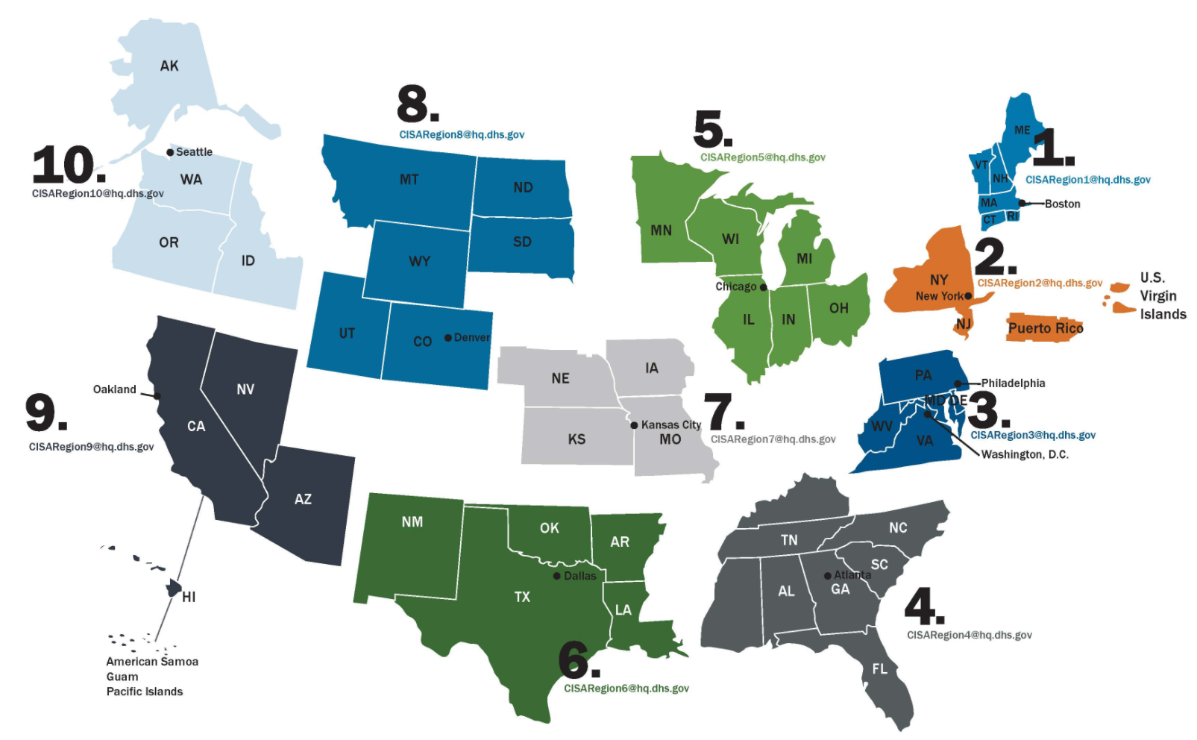
CISA Regional Offices
4

Slide 5
CISA Region 3
Provides steady state and incident operations support, critical infrastructure analysis and strategic outreach to critical infrastructure partners
Conducts field operations for critical infrastructure protection efforts
Cyber Security Advisors (CSAs)
Protective Security Advisors (PSAs)
Chemical Security Inspectors (CSIs)
Emergency Communications Coordinators (ECCs)
Bombing Prevention Coordinators (BPCs)
Notes:
Some of the capabilities of the regional structure include steady state and incident operations support, critical infrastructure analysis, and strategic outreach to critical infrastructure partners. The region conducts field operations for critical infrastructure protection efforts through our field personnel that include our PSAs, CSIs, CSAs, and ECCs. I’ll address more detailed resources and how we can help later in the presentation.
Protective Security Advisors (PSAs)
Chemical Security Inspectors (CSIs)
Cyber Security Advisors (CSAs)
Emergency Communications Coordinators (ECCs)
CISA Region 8 supports the overall CISA effort to serve public and private sector critical infrastructure owners and operators across all 16 critical infrastructure sectors with training and exercise resources that focus on cybersecurity, physical infrastructure security, chemical security, and emergency communications.

Slide 6
State of Cybersecurity 2022
Every organization is at risk from cyber threats that can disrupt essential services and potentially result in impacts to security, national economic security, national public health or safety
Major Threat Themes:
Geopolitical Tensions (i.e., Russia’s invasion of Ukraine)
Interconnected Cyber-Physical Systems
Supply Chain Integrity
External Dependencies Blind Spots
Ransomware as a Service (RaaS)
6

Slide 7
Geopolitical Tensions
Given the invasion of Ukraine by Russia, CISA has been leaning forward to inform our industry partners of potential threats. We recommends all organizations—regardless of size—adopt a heightened posture when it comes to cybersecurity and protecting their most critical assets.
Russian State-Sponsored Advanced Persistent Threats:
Decades of malicious cyber activity including targeted critical infrastructure attacks
Use cyber as a key component of their force projection
Recognize that disabling / destroying critical infrastructure can augment pressure on a country and accelerate their acceding to Russian objectives
Have the potential to escalate its destabilizing actions in ways that may impact others outside of Ukraine
NOTE: While there are not currently any specific credible threats to the U.S. homeland, we are mindful of the potential for the Russian government to consider escalating its destabilizing actions in ways that may impact others outside of Ukraine.
7

Slide 8
Understanding Russia’s Capabilities
High-Profile Cyber Attacks
2020 compromise of the SolarWinds software supply chain
2020 targeting of U.S. companies developing COVID-19 vaccines
2018 and 2020 Mis- Dis- Maliformation campaigns in elections
2018 targeting of U.S industrial control system infrastructure
2017 NotPetya ransomware attack on organizations worldwide
2016 leaks of documents stolen from the U.S. Democratic National Committee
2016 GRIZZLY STEPPE via spearphishing
2015 BlackEnergy disruption of Ukrainian electricity
Targeted key industries & organizations in the United States:
COVID-19 Research
Healthcare and Pharmaceuticals
Governments and Elections
Defense
Nuclear and Energy
Water
Aviation
Critical Manufacturing
More…

Slide 9
Latest Russian State-Sponsored Activity & Advisories
Subscribe for Alerts: www.cisa.gov/subscribe-updates-cisa
Russian APT actors seen using sophisticated cyber capabilities (AA22-011A) Released January 2022
Destructive Malware Targeting Organizations in Ukraine (AA22-057A) February & April 2022
Strengthening Cybersecurity of SATCOM Providers & Customers (AA22-076A) March & May 2022
Russian Cyber Actors Exploiting Default Authentication and “PrintNightmare” (AA22-074A) March 2022
TTPs of Indicted State-Sponsored Russian Cyber Actors Targeting the Energy Sector (AA22-083A) March 2022
Russia State-Sponsored and Criminal Cyber Threats to Critical Infrastructure (AA22-110A) April & May 2022
As of March 21, 2022…
The Biden-Harris Administration has warned repeatedly about the potential for Russia to engage in malicious cyber activity against the United States. There is now evolving intelligence that Russia may be exploring options for potential cyberattacks.
9
Notes:
Subscribe to CISA Alerts
Russian threat may be more likely directed at communications, water, energy, etc., rather than financial services directly

Slide 10
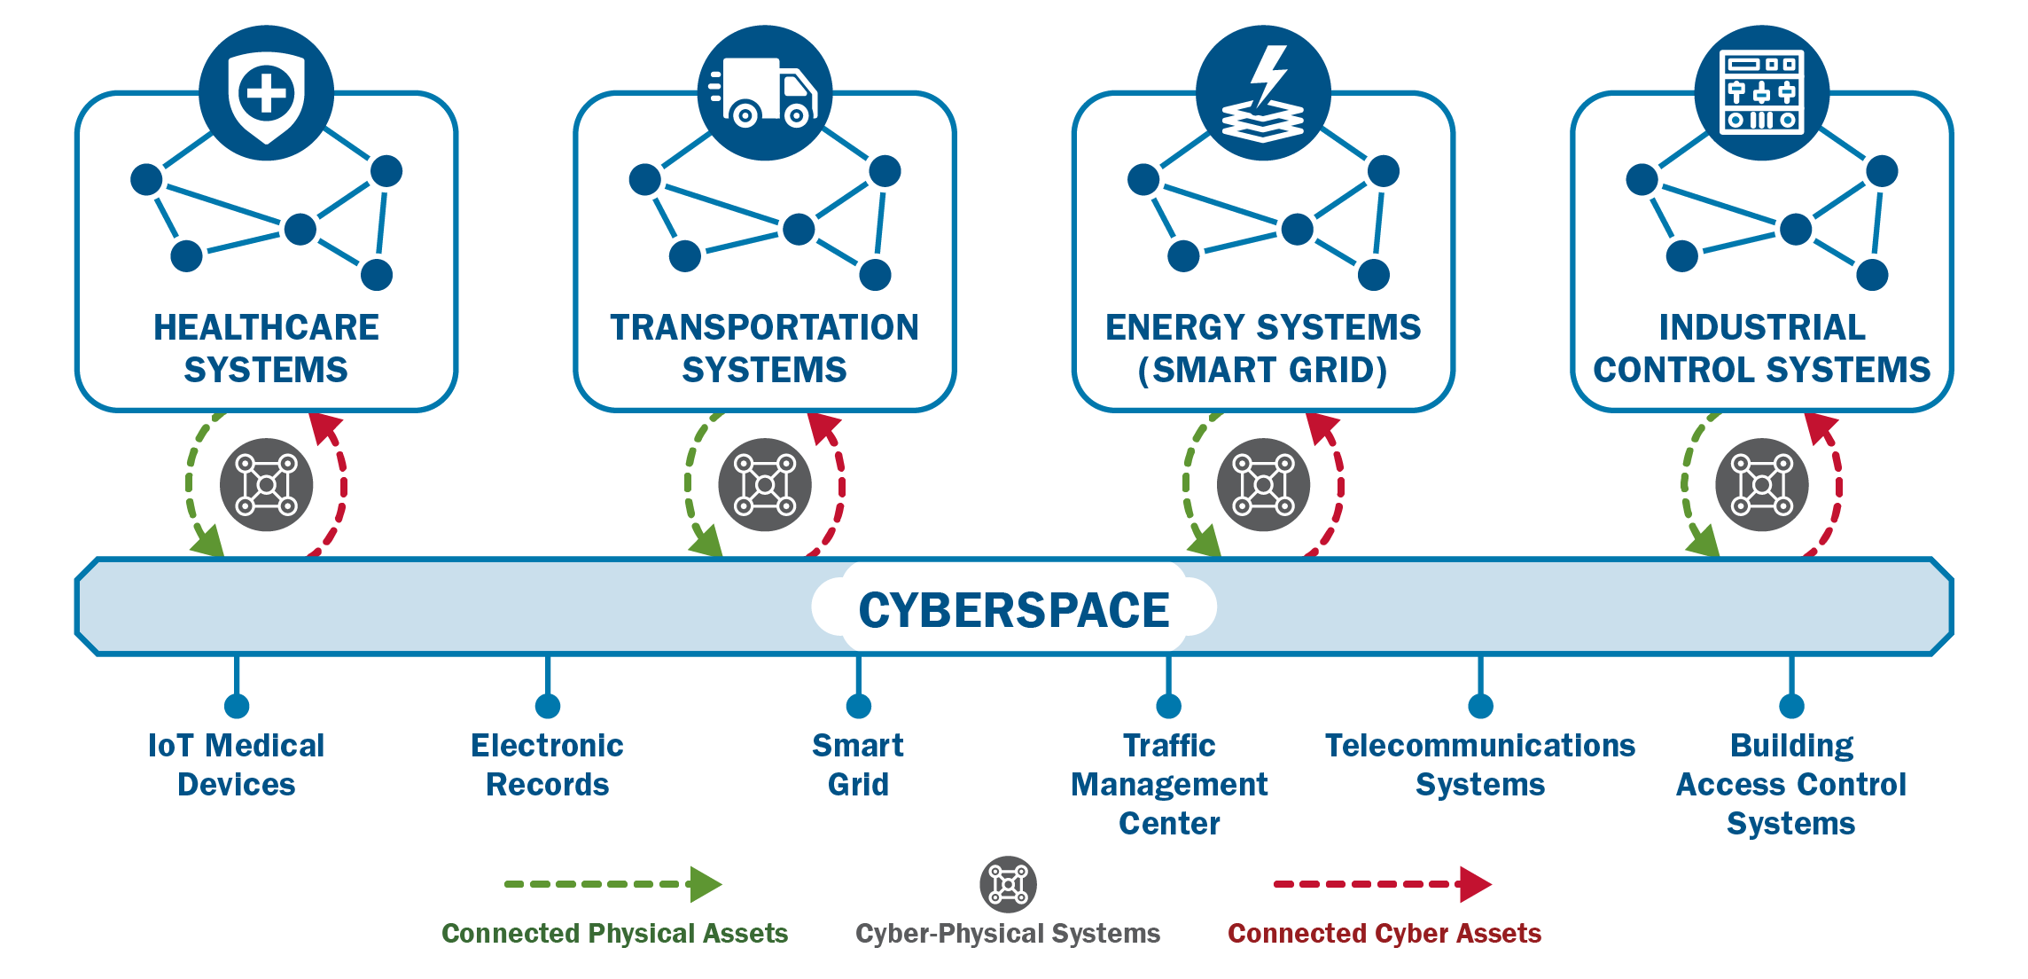
Cyber-Physical Convergence: A Connected Operating Environment

Slide 11
Supply Chain Blind Spots
We must anticipate cyber disruptions and supplier risks
SolarWinds, Kaseya, & Log4j

Slide 12
RANSOMWARE IS NOT LONGER JuST… INFECT, ENCRYPT, & EXTORT

Slide 13
The Evolution of Ransomware
Ransomware-as-a-Service
Double/Triple Extortion
3rd Party Service Providers
Cyber Insurance War Exclusions
13

Slide 14
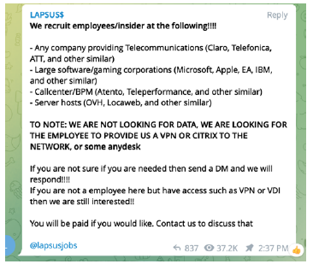
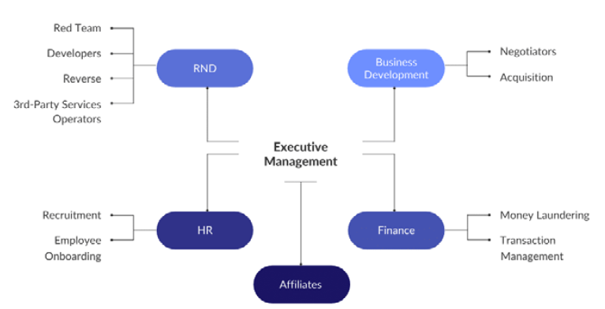
The Evolution of Ransomware: RaaS
Conti Organization Structure
Lapsus$ Recruitment Notice
14

Slide 15
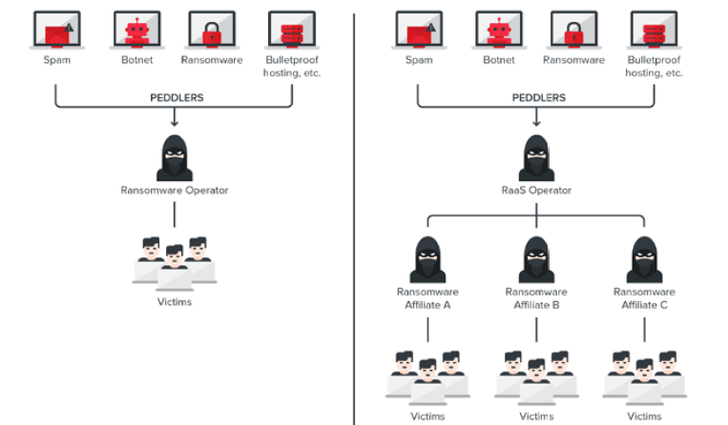
The Evolution of Ransomware: RaaS
Traditional Ransomware vs RaaS
15

Slide 16
The Evolution of Ransomware: Multi-Extortion
Pay ransom to unencrypt the data
Pay ransom to not leak data
Pay ransom to stop additional attacks
16

Slide 17
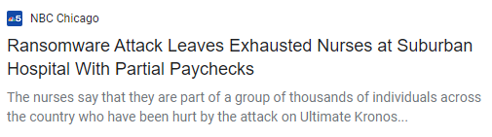
The Evolution of Ransomware: External Parties
Cyber attackers are going after managed service providers & 3rd party vendors
17

Slide 18
The Evolution of Ransomware: External Parties
Instances reported in open-source
32% SLTT
30% Health Care
23% Commercial Facilities
11% Transportation
2% Food
2% Non-Profit (YMCA)
Data Centers in US, Frankfurt, and Amsterdam affected
Forced thousands to enact continuity plans for payroll production
Widespread panic, fear, and rife prior to Christmas holiday
18

Slide 19
The Evolution of Ransomware: War Exclusions
War exclusion clause in an insurance contract meaning the insurer will not be obligated to pay for losses caused by war-related events
Some tried to exclude coverage for NotPetya malware infections
Russia Sanctions Complicate Paying Ransomware Hackers
Ransomware has declined since Russian sanctions
19

Slide 20
Potential Future Impacts of Cyber Attacks
Potential Future Impacts > Loss of Critical Data + Financial Loss + Damage to Reputation
Water Treatment Tampering & Poisoning
Blast Furnace Explosions
Power Grids Blackout
Safety System Failures (i.e., Cameras, Fire Alarms, Temperature Monitors, etc.)
Loss of Life
Notes:
The potential impacts of malware are much greater than those of the past. Today, we have to accept that these are the new potential impacts of malware because of our interconnected digital world.

Slide 21
JUST HOW VULNERABLE ARE SLTT SYSTEMS AND NETWORKS?

Slide 22
FY2021 Results for SLTT Entities
CISA collected data and information from:
1,115 enrolled in Cyber Hygiene (CyHy) Vulnerability Scanning
167 – State
939 – Local
6 – Tribal
3 – Territorial
281 entities enrolled in Web Application Scanning (WAS)
195 cybersecurity assessments
Notes:
We look at resilience through a broad lens encompassing cyber risk as well as other risks your organization faces. Operational resilience emerges through understanding, identifying, and managing risk – regardless of the type of risk.

Slide 23
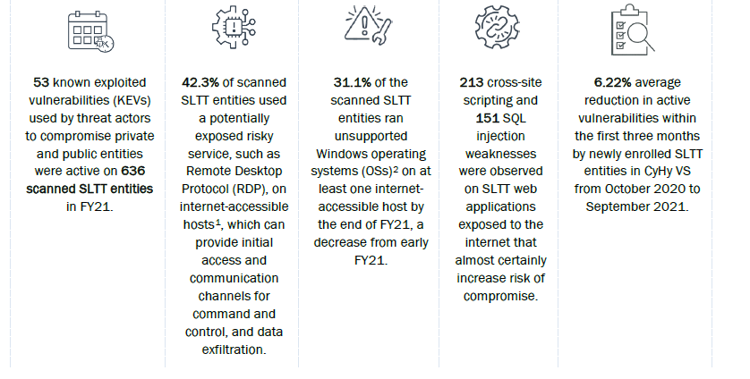
FY2021 Results for SLTT Entities
Notes:
We look at resilience through a broad lens encompassing cyber risk as well as other risks your organization faces. Operational resilience emerges through understanding, identifying, and managing risk – regardless of the type of risk.

Slide 24
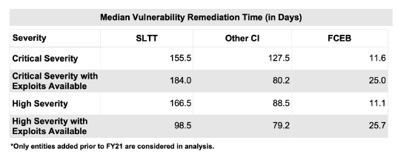
More SLTT Stats…
44% percent of all vulnerabilities remained active by the end of FY21
Some vulnerabilities were active for more than two years, up to five years
Median days to remediate critical severity vulnerabilities for SLTT entities was 1.2 times slower and median days to remediate high severity vulnerabilities was 1.9 times slower

Slide 25
SHIFT IN MINDSET: “NOT IF, BUT WHEN”

Slide 26
Build a Cyber Resilient Organization
“… the ability to prepare for and adapt to changing conditions and withstand and recover rapidly from disruptions. Resilience includes the ability to withstand and recover from deliberate attacks, accidents, or naturally occurring threats or incidents…”
- Presidential Policy Directive 21 February 12, 2013
Protect (Security) | Sustain (Continuity)
Perform (Capability) | Repeat (Maturity)
Notes:
This is the official definition of resiliency per the presidential policy directive we work under.
Resiliency is essential for critical infrastructure because it’s the thinking we need to anticipate that our respective organizations will be attacked. Because the concept of best cybersecurity doesn’t work anymore. We know that web application security, email gateway security, firewalls, and other cyber defenses are failing us.

Slide 27
How Do I Become Cyber Resilient?
Cyber resilience emerges from what we do! We cannot buy it.
The same way we achieve good health.
Exercising, eating right, getting enough sleep, getting routine check-ups, or seeking out specialist to help with specific issues
Avoiding risky behavior whenever possible
Good health emerges from these activities! Similarly, operational resilience emerges from the activities we do.
Notes:
We look at resilience through a broad lens encompassing cyber risk as well as other risks your organization faces. Operational resilience emerges through understanding, identifying, and managing risk – regardless of the type of risk.
Identifying and mitigating risks,
Planning for and managing vulnerabilities and incidents,
Performing service-continuity processes and planning,
Managing IT operations,
Managing, training, & deploying people,
Protecting and securing important assets, and
Working with external partners.

Slide 28
Operational Resilience in Practice
Operational resilience emerges from what we do, such as:
Identifying and mitigating risks,
Planning for and managing vulnerabilities and incidents,
Performing service-continuity processes and planning,
Managing IT and OT operations,
Managing, training, & deploying people,
Protecting and securing important assets,
Sharing intelligence data and information, and
Working with external partners.
Notes:
We look at resilience through a broad lens encompassing cyber risk as well as other risks your organization faces. Operational resilience emerges through understanding, identifying, and managing risk – regardless of the type of risk.

Slide 29
Sampling of Voluntary & No-Cost Cybersecurity Offerings
Assessments & Evaluations
Cyber Resilience Reviews (CRR™)
Cyber Infrastructure Surveys
Phishing Campaign Assessment
Vulnerability Scanning & Web Application Scanning
Risk and Vulnerability Assessments (aka “Pen” Tests)
External Dependencies Management Reviews
Cyber Security Evaluation Tool (CSET™)
Validated Architecture Design Review (VADR)
Preparedness Activities
Information / Threat Indicator Sharing
Cybersecurity Training and Awareness
Cyber Exercises and “Playbooks”
National Cyber Awareness System
Vulnerability Notes Database
Information Products and Recommended Practices
Workshops (Cyber Resilience, Cyber Incident Management, Election Security, etc.)
Partnership Development
Informational Exchanges
Working Group Support
Strategic Messaging & Advisement
Resource Briefings
Keynotes and Panels
Threat Briefings
Topic Specifics (e.g., NCSAM, SCRM, ICS, etc.)
Incident Response Assistance
Remote / On-Site Assistance
Malware Analysis
Hunt and Incident Response Teams
Incident Coordination
Targeted (Victim) Notifications
Notes:
Now, some information about my role. As mentioned, I am a region 3 cybersecurity advisor (referred to as a CSA) and the Delaware cyber state coordinator. In both roles, I provide direct coordination, outreach, and regional support and assistance to strengthen cybersecurity and enhance cyber resilience. All the work that I do is voluntary meaning that it’s not regulatory and you opt-in into a partnership with CISA. We also protect your information and cannot share it.
This slide shows a sampling of the no-cost cybersecurity offerings. Please feel free to reach out to me after the workshop, so that I can tailor some of the cybersecurity services for your organization.

Slide 30
Range of Cybersecurity Assessments
STRATEGIC
(C-Suite Level)
Cyber Resilience Review (Strategic)
External Dependencies Management (Strategic)
Cyber Infrastructure Survey (Strategic)
Cybersecurity Evaluations Tool (Standards)
Phishing Campaign Assessment (EVERYONE)
Validated Architecture Design Review (Tactical)
Cyber Hygiene (Technical)
Vulnerability Scanning
Web Application Scanning
Remote Penetration Test
Risk and Vulnerability Assessment (Technical)
TECHNICAL
(Network-Administrator Level)
30

Slide 31
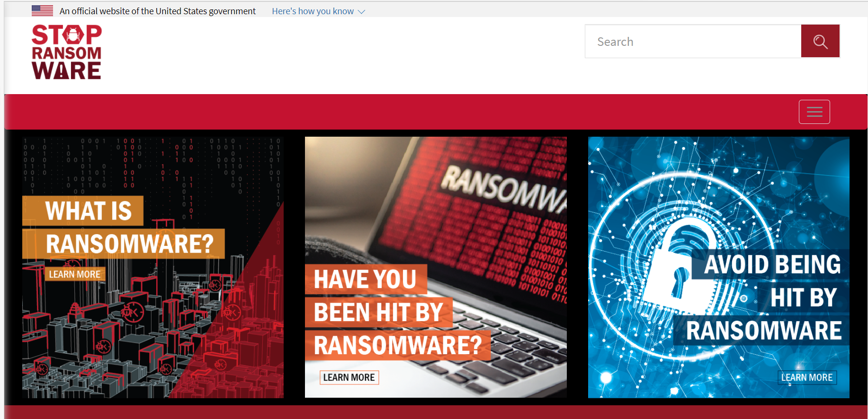
Federal Ransomware Website: StopRansomware.gov
Visit StopRansomware.gov today!
BLAN
Notes:
On July 15, 2021 the USG launched a new interagency website to help both public and private organizations defend against the rise in ransomware attacks. StopRansomware.gov is a whole-of-government resource that provides one central location for ransomware-related tools, reports, the latest alerts, and other resources such as cyber hygiene services.
Alerts and Statements
These alerts are geared toward system administrators and other technical staff to bolster their organization’s security posture. All CISA’s alerts, statements, and joint advisories from US-CERT relating to ransomware are on this webpage as a reference.
Guides and Services
This link has the Ransomware Guide, which is a customer centered, one-stop resource with best practices and ways to prevent, protect and/or respond to a ransomware attack; Cyber Hygiene Services, which has several scanning and testing services to help organizations assess, identify and reduce their exposure to threats, which I will introduce in the next few slides. Cyber Security Evaluation Tool (CSET): the Ransomware Readiness Assessment (RRA).
Rise in Ransomware Targeting Operational Technology Assets
CISA has published the Rising Ransomware Threat to OT Assets fact sheet in response to the recent increase in ransomware attacks targeting operational technology (OT) assets and control systems. The guidance: provides steps to prepare for, mitigate against, and respond to attacks; details how the dependencies between an entity’s IT and OT systems can provide a path for attackers; and explains how to reduce the risk of severe business degradation if affected by ransomware.
CISA encourages critical infrastructure (CI) owners and operators to review the Rising Ransomware Threat to OT Assets fact sheet as well as CISA’s Ransomware webpage to help them in reducing their CI entity’s vulnerability to ransomware.
https://us-cert.cisa.gov/ncas/current-activity/2021/06/09/cisa-addresses-rise-ransomware-targeting-operational-technology
Factsheets and Infographics
This section includes easy-to-use, straightforward information to help organizations and individuals better understand the threats from and the consequences of a ransomware attack. This has the CISA INSIGHT on Ransomware attacks, A poster you can hang in your workplace, a joint technical fact sheet from our NCIJTF law enforcement partners on “Ransomware: What it is and what to do about it”, and finally, a US-CERT security tip on Protecting Against Ransomware.
Training and Webinars
It includes the Cybersecurity 101 Video Series, an Incident Response Training Series with a webinar recording, as well as CISA’s Webinar on “Combating Ransomware” and the recording from the CISA Cyber Summit 2020 Ransomware Panel session.
NEW Ransomware Campaign Toolkit
These toolkit resources located on CISA.gov are designed to help our partner organizations, as well as state, local, tribal, and territorial (SLTT) officials bring awareness to ransomware risks and how to mitigate them. Each week our key messages will update with social media images that we encourage our trusted partners to use.
Resources for K-12 Sector
The webpage also has resources designed to help individuals and K-12 educational institutions remain secure, to include material specifically for K-12 students, resources for parents, teachers, and school administrators, and a section for K-12 IT staff.

Slide 32
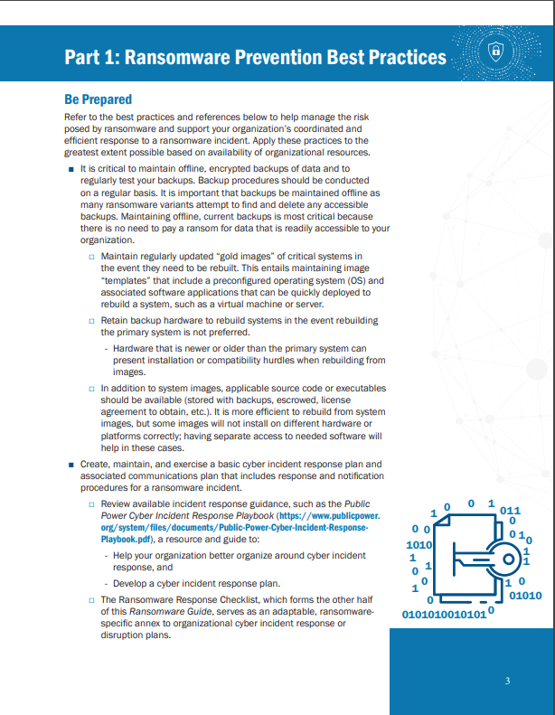
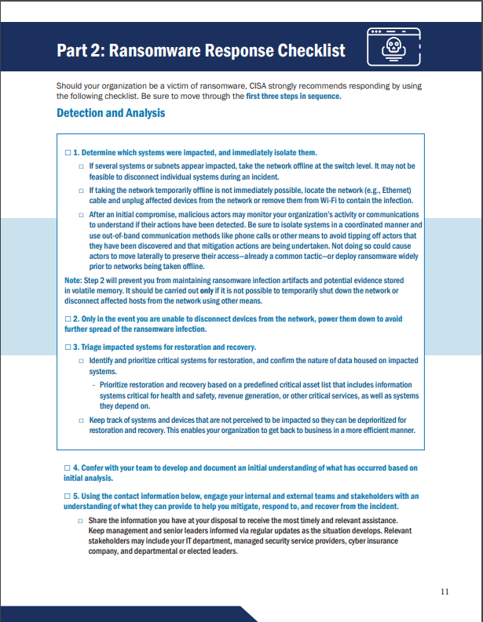
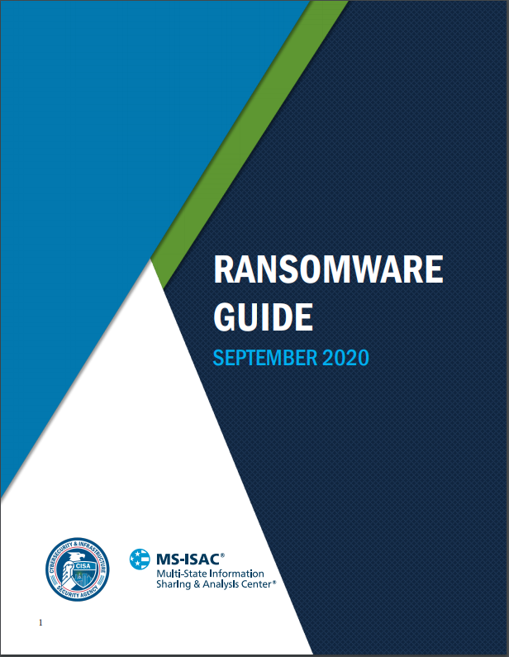
Ransomware Guide
Joint CISA and MS-ISAC Ransomware Guide
Part 1: Ransomware Prevention Best Practices
Part 2: Ransomware Response Checklist
BLAN
Notes:
In fall 2020, CISA and the MS-ISAC released a joint Ransomware Guide, which is a customer centered, one-stop resource with best practices and ways to prevent, protect and/or respond to a ransomware attack. CISA and MS-ISAC are distributing this guide to inform and enhance network defense and reduce exposure to a ransomware attack. The Guide is broken into two parts:
Part 1: Ransomware Prevention Best Practices
Part 2: Ransomware Response Checklist
This is one of our resources we are promoting throughout the Ransomware Campaign since it’s available to the public, anyone can access this useful Guide. I’m going to walk you through some of the information contained in it for more details.

Slide 33
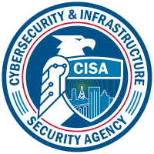
Incident Coordination & Response
Contact CISA
Report cybersecurity incidents and vulnerabilities:
888-282-0870
central@cisa.gov
Threat Hunting Services
Provides incident response, management and coordination activities for cyber incidents occurring in the critical infrastructure sectors as well as government entities at the Federal, State, Local, Tribal, and Territorial levels

Slide 34
Arielle Baine
Cybersecurity Advisor, Region 3
Delaware Cyber State Coordinator
Arielle.Baine@cisa.dhs.gov
Regional Support:
CISARegion3@hq.dhs.gov
To Report an Incident:
https://us-cert.cisa.gov/report
Media Inquiries:
CISAMedia@cisa.dhs.gov

